Slide 1
NETWORK TOOLS
Team 1: Aidan Curley, Alice Villar, Ian Wolloff, Lukman Mohamed
MSc In Computer Science, University of Essex Online, UK
Module 4 – Network and Information Security Management
Unit 3 – Practical Activity

Slide 2

COMPUTER NETWORKING EXERCISES
The exercises are done with the
following tools:
Ping - See if a host is reachable.
Traceroute - Trace the network path from this server to another.
NsLookup - Look up various domain resource records.
Whois - Get Whois records for domains worldwide.
Netstat - for troubleshooting and configuration.

Slide 3

PING
Ping is likely the number one utility that every tech pro will use on a daily basis. It helps us to determine two things: latency and packet loss.
A ping (Packet Internet or Inter-Network Groper) is a basic internet program that allows a user to test and verify if a particular destination IP address exists and can accept requests.
Ping is also used diagnostically to ensure that a host computer the user is trying to reach is operating.

Slide 4
TRACEROUTE
Traceroute is a network diagnostic tool used to track in real-time the pathway taken by a packet on an IP network from source to destination.
It reports the IP addresses of all the routers it pinged and records the time taken for each hop the packet makes.
Traceroute is useful for determining the response delays and routing loops present in a network pathway across packet switched nodes.
However, its messages are often blocked by routers, making traceroute inaccurate in many cases.

Slide 5
NSLOOKUP
Nslookup is an abbreviation of “name server lookup”.
Nslookup is used to find the IP address that corresponds to a host, or the domain name that corresponds to an IP address (a process called “Reverse DNS Lookup”).

Slide 6
WHOIS
Whois, pronounced "who is", allows users to look up the name and contact information of a registered domain name (website).
Whois is a widely used Internet record listing that identifies who owns a domain and how to get in contact with them.

Slide 7
NETSTAT
The network statistics (netstat) command is a networking tool used for troubleshooting and configuration, that can also serve as a monitoring tool for connections over the network.
Netstat checks which ports on your hosts are open and listening.
Netstat tells us who else is connected to our host and on what ports. This can be especially helpful if we suspect that our security has been compromised.

Slide 8

PRACTICAL ACTIVITY SCANNING EXERCISE

Slide 9
1) How many hops from your machine to your assigned website?
Hop | IP Address | Address | Time (ms)
1 | 192.168.0.1 | N/A | 16.479
2 | *** | N/A (Probably Due to Blocked ICMP Traffic) | N/A
3 | 80.0.142.213 | cosh-core-2b-ae50-0.network.virginmedia.net | 20.899
4 | 62.254.42.174 | m686-mp2.cvx1-b.lis.dial.ntli.net | 20.546
5 | 213.46.174.118 | 213.46.174.118 | 24.314
6 | 62.115.120.238 | ldn-bb4-link.ip.twelve99.net | 20.183
7 | 62.115.122.188 | ldn-bb1-link.ip.twelve99.net | 18.965
8 | 213.155.136.99 | adm-bb3-link.ip.twelve99.net | 24.649
9 | 62.115.134.26 | adm-bb4-link.ip.twelve99.net | 25.631
11 | 62.115.120.227 | adm-b10-link.ip.twelve99.net | 28.558
12 | 62.115.120.229 | adm-b10-link.ip.twelve99.net | 28.077
13 | 62.115.145.217 | a2hosting-svc080530-ic370345.ip.twelve99-cust.net | 23.079
14 | 209.124.94.237 | 209.124.94.237.static.a2webhosting.com | 27.466
15 | 68.66.247.187 | 68.66.247.187.static.a2webhosting.com | 26.261
Hops (11,12) (6,7) and (8,9) can be treated as one hop each.
On our traceroute output these are treated as one hop.
This is probably down to being a load balanced switch.
There are 12 distinct Hops between the starting address and the final website.
LINUX COMMAND: sudo traceroute daedalus-systems.co.uk

Slide 10
2) Which step causes the most significant delay in the route? What is the average duration of that delay?
The Biggest Delay in the route is 28.588ms (adm-b10-link.ip.twelve99.net)
From our Traceroute at this step we had the following for 2 packets recorded 28.588 and 26.916 for this link giving an average of
(26.916 + 28.588) / 2 = 27.752
This, however, is a very small dataset and if we wanted a fair result, we would have to repeat the test a number of times to get a true idea if this really was the link with the lowest performance or if this was due to traffic or some other network conditions at the time we ran the original traceroute command.
LINUX COMMAND: sudo traceroute daedalus-systems.co.uk

Slide 11
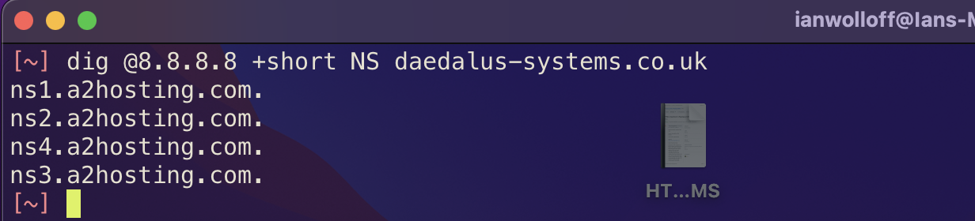
3) What are the primary nameservers for the website?
Using the dig command with the NS flag we can get the nameservers for the website.
By taking these domains and running a nslookup command on them we can also get the IP address of the name servers producing the list below.
ns1.a2hosting.com (162.159.25.95)
ns2.a2hosting.com (162.159.24.221)
ns3.a2hosting.com (162.159.25.82)
ns4.a2hosting.com (162.159.24.227)
COMMAND: dig +short NS daedalus-systems.co.uk
nslookup

Slide 12
4) Who is the registered contact?
# whois.nic.uk
Domain name:
daedalus-systems.co.uk
Data validation:
Nominet was able to match the registrant's name and address against a 3rd party data source on 01-Aug-2020
Registrar:
eNom LLC [Tag = ENOM]
URL: http://www.enom.com
Relevant dates:
Registered on: 01-Aug-2020
Expiry date: 01-Aug-2022
Last updated: 01-Aug-2021
Registration status:
Registered until expiry date.
Name servers:
ns1.a2hosting.com
ns2.a2hosting.com
ns3.a2hosting.com
ns4.a2hosting.com
WHOIS lookup made at 10:23:48 22-Nov-2021
COMMAND: whois daedalus.co.uk

Slide 13
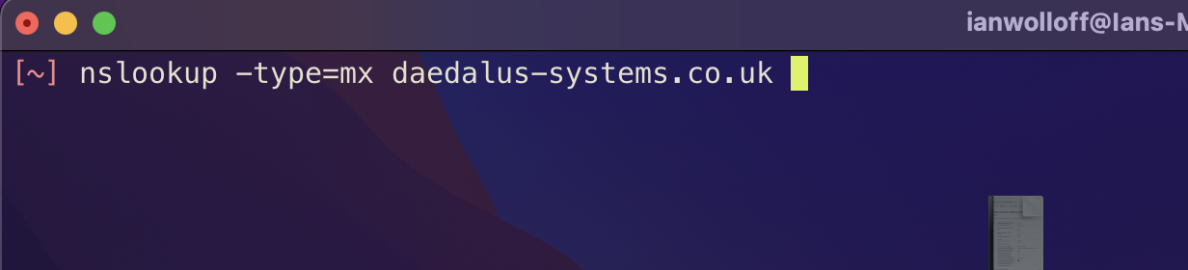
5) What is the MX record for the website?
To lookup the MX (Mail Exchange) record for a site we can use the nslookup command with the type set to mx
This then returns the following information on the MX record
Server: 208.67.222.222
Address: 208.67.222.222#53
Non-authoritative answer:
daedalus-systems.co.uk mail exchanger = 0 mail.daedalus-systems.co.uk.
COMMAND: nslookup -type=mx daedalus-systems.co.uk

Slide 14
6) Where is the website hosted?
We used a python script that takes a dictionary of IP addresses obtained from traceroute and searched the dataset provided by freegeoip to return information about the IP address.
import json
import urllib.request
import socket
IP_Address = ["62.115.120.238", "209.124.94.237"]
Resolver = "https://freegeoip.app/json/"
try:
for hop, ip in enumerate(IP_Address):
with urllib.request.urlopen(Resolver + ip) as url:
data = json.loads(url.read().decode())
print("Hop Number:" + str(hop))
print("IP Address:" + data["ip"]
print("Country Code:" + data["country_code"])
print("Country Name:" + data["country_name"])
print("Time Zone:" + data["time_zone"])
print("Latitude:" + str(data["latitude"]))
print("Longitude:" + str(data["longitude"]) + "\n")
except urllib.request.URLError:
print("Error Getting Data")
except KeyError:
print("Error Getting JSON Key")
Scanning the results we can determine the traffic path as: UK, Sweden, Netherlands, USA

Slide 15
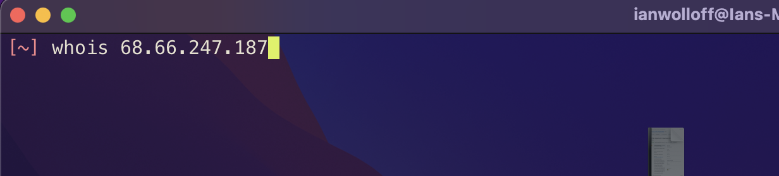
6) Where is the website hosted?
The end point can be further verified by doing a whois on the last IP address in our traceroute chain
OrgName: | A2 Hosting, Inc.
OrgId: | A2HOS
Address: | P.O. Box 2998
City: | Ann Arbor
StateProv: | MI
PostalCode: | 48106
Country: | US
RegDate: | 2004-03-16
Updated: | 2021-10-13
Comment: | http://www.a2hosting.com
Ref: | https://rdap.arin.net/registry/entity/A2HOS

Slide 16
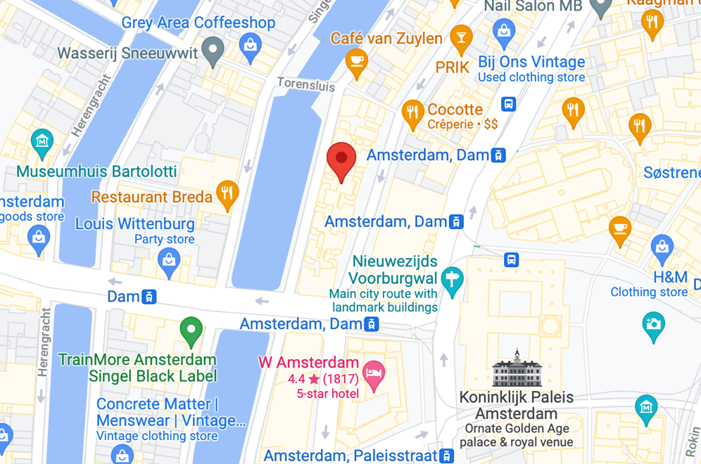
6) Where is the website hosted?
This however is not the whole story. We know the site is hosted with a2hosting.
While this provider is US based and their core network is US based but from lookup up public information about this provider https://www.a2hosting.com/about/data-center (Anon) we can see that they have a number of data centres located in the following areas.
Country | City | IP Range
USA | Michigan | 75.98.175.109
USA | Arizona | 68.66.224.6
Netherlands | Amsterdam | 68.66.248.31
Asia | Singapore | 03.227.176.4
From our traceroute result we can see our last hop is 68.66.247.187 which would seem to indicate that our site is actually physically hosted in:
a2hosting Amsterdam datacentre.
Likely Location of Amsterdam Datacentre based on Public Lat / Lon Values

Slide 17
REFERENCES
What is Traceroute & What is it For? - ThousandEyes
https://www.thousandeyes.com/learning/glossary/traceroute
Data Center | Datacenter Hosting Options. [Online]. Available at: https://www.a2hosting.com/about/data-center [Accessed 22 November 2021].
Top 10 network tools all IT pros should have in their toolbox – Plural Sight
https://www.pluralsight.com/blog/it-ops/best-network-troubleshooting-tools
Utilitários de rede - UFES
http://www.inf.ufes.br/~zegonc/material/Redes_de_Computadores/Utilitarios%20de%20Rede%20(Lab2).pdf

